Slide 1

Ethics and Ecological Wisdom: Environmental Conservation and Awareness
Information Security Fundamentals | Ecological Behaviour and Knowledge Management
Course: Information Security Fundamentals | Chapter: Ecological Behaviour and Knowledge Management | Program: Bachelor of Engineering
DISCOVER · LEARN · EMPOWER
Notes:
Welcome to this lecture on Ethics and Ecological Wisdom. We will explore how ancient Indian traditions and modern case studies like Delhi's CNG initiative shape our environmental behavior. This session bridges the gap between spiritual wisdom and practical engineering solutions for pollution control. Let us begin by understanding the deep connection between culture and conservation.

Slide 2
Course Outcomes
SLIDE 2 / 14
Course Outcome
CO | BT LEVEL | DESCRIPTION
CO1 | BT4 | Recall, analyze and respond on fundamental environmental principles, such as ecological relationships and conservation strategies
CO2 | BT4 | Understand and analyze the interconnections between human activities and environmental impacts across different ecosystems
CO3 | BT4 | Understand and analyze and apply environmental laws and policies to analyse and propose solutions for real-world environmental challenges.
CO4 | BT2 | Students will analyse data from environmental monitoring programs to assess trends and predict future impacts on ecosystems.
CO5 | BT6 | Interpret, elaborate and propose various tools, design and innovative strategies for sustainable development and environmental conservation initiatives in securing the planet.
Chandigarh University
2 / 14
Notes:
Our primary learning outcome for this lecture is CO4. You will learn to analyze data from environmental monitoring programs to assess trends and predict future impacts on ecosystems. This skill is crucial for understanding how human actions alter ecological balance over time. We will apply this by looking at real-world pollution data and conservation metrics.

Slide 3
Learning Objectives
SLIDE 3 / 14
Learning Outcomes
1
Identify the role of Indian religions in promoting ecological wisdom and conservation ethics.
2
Explain how ecological worldviews influence modern environmental communication and public awareness strategies.
3
Analyze the quantitative impact of CNG vehicles on Delhi's air quality and pollution levels.
4
Evaluate the relationship between consumerism, energy conservation, and sustainable resource management practices.
5
Assess the ethical challenges in resettlement and rehabilitation of persons affected by development projects.
Chandigarh University
3 / 14
Notes:
By the end of this session, you will be able to identify the role of Indian religions in promoting ecological wisdom. You will also explain how ecological worldviews influence modern environmental communication and public awareness strategies. We will analyze the quantitative impact of CNG vehicles on Delhi's air quality and pollution levels. Finally, we will assess the ethical challenges in resettlement and rehabilitation of persons affected by development projects.

Slide 4
Lecture
SLIDE 4 / 14
Indian Religions and Ecological Wisdom
1
Hinduism teaches that nature is divine, with rivers like Ganga considered sacred entities requiring protection.
2
Buddhism emphasizes non-violence (Ahimsa) towards all living beings, fostering a deep respect for biodiversity.
3
Jainism promotes extreme vegetarianism and non-harming, directly reducing the ecological footprint of consumption.
4
Sikhism advocates for 'Seva' (selfless service), encouraging community efforts in cleaning and planting trees.
5
Ancient texts like the Rig Veda describe nature as a living entity with which humans must coexist.
File:Prayers-collage.png - Wikimedia Commons
Chandigarh University
4 / 14
Notes:
Indian religions provide a foundational ethical framework for environmental conservation. Hinduism teaches that nature is divine, with rivers like Ganga considered sacred entities requiring protection. Buddhism emphasizes non-violence towards all living beings, fostering a deep respect for biodiversity. These ancient beliefs form the bedrock of our ecological wisdom today.

Slide 5
Lecture
SLIDE 5 / 14
Ecological Worldview and Communication
1
An ecological worldview shifts focus from human dominance to human interdependence with natural systems.
2
Effective environmental communication translates complex scientific data into relatable stories for public engagement.
3
Public awareness campaigns must use local languages and cultural symbols to resonate with diverse communities.
4
Misinformation spreads rapidly; accurate data visualization is essential for building trust in conservation efforts.
5
Communication strategies must address both individual behavioral changes and systemic policy reforms simultaneously.
Chandigarh University
5 / 14
Notes:
An ecological worldview shifts focus from human dominance to human interdependence with natural systems. Effective environmental communication translates complex scientific data into relatable stories for public engagement. Public awareness campaigns must use local languages and cultural symbols to resonate with diverse communities. Misinformation spreads rapidly, so accurate data visualization is essential for building trust in conservation efforts.

Slide 6
Case Study
SLIDE 6 / 14
CNG Vehicles in Delhi
1
Delhi introduced Compressed Natural Gas (CNG) in 2002 to reduce vehicular air pollution significantly.
2
CNG burns cleaner than petrol, reducing particulate matter (PM) emissions by approximately 90%.
3
The conversion required a massive infrastructure shift, including new fueling stations and vehicle modifications.
4
Monitoring data showed a 30% drop in suspended particulate matter within the first two years.
5
Challenges included higher initial costs and the need for a reliable supply chain across the city.
Chandigarh University
6 / 14
Notes:
Delhi introduced Compressed Natural Gas in 2002 to reduce vehicular air pollution significantly. CNG burns cleaner than petrol, reducing particulate matter emissions by approximately 90%. The conversion required a massive infrastructure shift, including new fueling stations and vehicle modifications. Monitoring data showed a 30% drop in suspended particulate matter within the first two years.

Slide 7
Lecture
SLIDE 7 / 14
Energy and Water Conservation Math
EFFICIENCY FORMULA
Energy Saved = (Old Consumption - New Consumption) × Hours of Operation.
EXAMPLE
Replacing a 100W bulb with a 20W LED saves 80W per hour of use.
• Energy conservation reduces the load on power plants and lowers greenhouse gas emissions globally.
• Water conservation is critical as only 2.5% of Earth's water is fresh and accessible for use.
• Over one year (8 hours/day), this single change saves 233.28 kWh of electricity annually.
Chandigarh University
7 / 14
Notes:
Energy conservation reduces the load on power plants and lowers greenhouse gas emissions globally. Water conservation is critical as only 2.5% of Earth's water is fresh and accessible for use. Efficiency formula: Energy Saved equals Old Consumption minus New Consumption × Hours of Operation. For example, replacing a 100W bulb with a 20W LED saves 80W per hour of use.

Slide 8
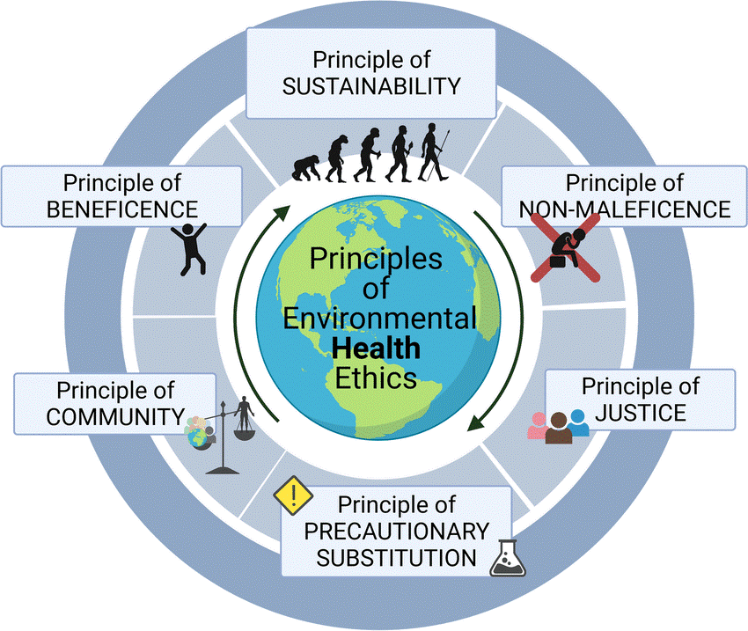
Lecture
SLIDE 8 / 14
Consumerism and Environmental Impact
1
Consumerism drives high resource extraction, leading to habitat destruction and increased carbon footprints.
2
Fast fashion and electronic waste are major contributors to global pollution and landfill overflow.
3
Sustainable consumption involves choosing durable goods and repairing items instead of immediate replacement.
4
The 'Reduce, Reuse, Recycle' hierarchy prioritizes waste reduction over end-of-pipe recycling solutions.
5
Ethical consumerism requires buyers to consider the entire lifecycle of a product's environmental cost.
Environmental Ethics in Indian Philosophy: Harmony of Nature and Spirit (source: www.insightsonindia.com)
Chandigarh University
8 / 14
Notes:
Consumerism drives high resource extraction, leading to habitat destruction and increased carbon footprints. Fast fashion and electronic waste are major contributors to global pollution and landfill overflow. Sustainable consumption involves choosing durable goods and repairing items instead of immediate replacement. The 'Reduce, Reuse, Recycle' hierarchy prioritizes waste reduction over end-of-pipe recycling solutions.

Slide 9
Lecture
SLIDE 9 / 14
Commitment to Environmental Organizations
1
Environmental organizations bridge the gap between individual actions and large-scale policy advocacy.
2
Volunteering with groups like WWF or local NGOs provides practical experience in conservation projects.
3
Corporate social responsibility (CSR) initiatives often fund reforestation and water purification programs.
4
Student engagement in these organizations fosters leadership skills and a sense of global citizenship.
5
Collaboration between scientists and NGOs ensures that conservation efforts are based on solid data.
Environmental Ethics in Indian Philosophy: Harmony of Nature and Spirit (source: www.insightsonindia.com)
Chandigarh University
9 / 14
Notes:
Environmental organizations bridge the gap between individual actions and large-scale policy advocacy. Volunteering with groups like WWF or local NGOs provides practical experience in conservation projects. Corporate social responsibility initiatives often fund reforestation and water purification programs. Student engagement in these organizations fosters leadership skills and a sense of global citizenship.

Slide 10
Pollution Case Studies
SLIDE 10 / 14
Industrial Emissions
1
Industrial emissions are a primary source of air pollutants like sulfur dioxide and nitrogen oxides.
2
The Bhopal Gas Tragedy highlights the catastrophic human cost of industrial negligence and safety failures.
3
Air Quality Index (AQI) monitoring helps identify pollution hotspots and triggers emergency response protocols.
4
Regulatory frameworks mandate the use of scrubbers and filters to reduce toxic emissions from factories.
5
Continuous monitoring is essential to ensure compliance with national and international pollution standards.
Chandigarh University
10 / 14
Notes:
Industrial emissions are a primary source of air pollutants like sulfur dioxide and nitrogen oxides. The Bhopal Gas Tragedy highlights the catastrophic human cost of industrial negligence and safety failures. Air Quality Index monitoring helps identify pollution hotspots and triggers emergency response protocols. Regulatory frameworks mandate the use of scrubbers and filters to reduce toxic emissions from factories.

Slide 11
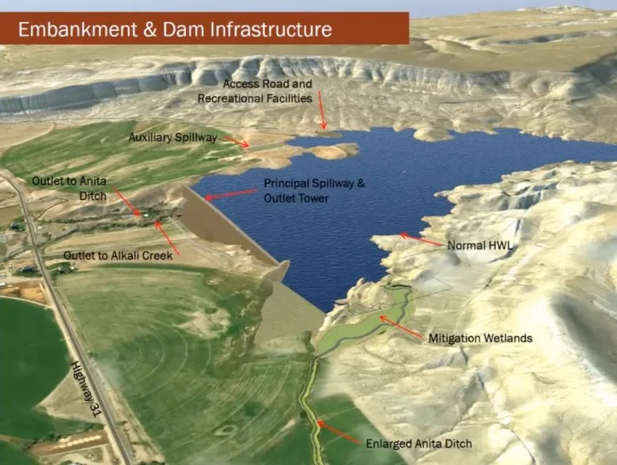
Lecture
SLIDE 11 / 14
Resettlement and Rehabilitation Challenges
1
Large infrastructure projects often displace communities, requiring comprehensive resettlement and rehabilitation plans.
2
Loss of land and livelihoods creates long-term socio-economic instability for affected families.
3
Successful rehabilitation requires fair compensation, skill development, and access to new employment opportunities.
4
Ethical standards demand that displaced persons are consulted and involved in the planning process.
5
Failure to address these issues leads to social unrest and long-term environmental degradation.
Source: i0.wp.com
Chandigarh University
11 / 14
Notes:
Large infrastructure projects often displace communities, requiring comprehensive resettlement and rehabilitation plans. Loss of land and livelihoods creates long-term socio-economic instability for affected families. Successful rehabilitation requires fair compensation, skill development, and access to new employment opportunities. Ethical standards demand that displaced persons are consulted and involved in the planning process.

Slide 12
Lecture
SLIDE 12 / 14
Common Pitfalls in Environmental Ethics
1
Ignoring local cultural contexts can lead to the rejection of well-intentioned conservation initiatives.
2
Focusing solely on technology without behavioral change results in temporary or ineffective solutions.
3
Over-reliance on voluntary measures without regulatory enforcement often fails to curb pollution.
4
Neglecting the voices of indigenous communities undermines the sustainability of long-term projects.
5
Short-term economic gains are often prioritized over long-term ecological stability and health.
Environmental Ethics in Indian Philosophy: Harmony of Nature and Spirit (source: www.insightsonindia.com)
Chandigarh University
12 / 14
Notes:
Ignoring local cultural contexts can lead to the rejection of well-intentioned conservation initiatives. Focusing solely on technology without behavioral change results in temporary or ineffective solutions. Over-reliance on voluntary measures without regulatory enforcement often fails to curb pollution. Neglecting the voices of indigenous communities undermines the sustainability of long-term projects.

Slide 13

Lecture
SLIDE 13 / 14
Key Takeaways
1
Indian religions provide a strong ethical foundation for ecological wisdom and conservation practices.
2
Effective communication is vital for translating scientific data into public awareness and action.
3
CNG adoption in Delhi demonstrates the tangible benefits of policy-driven environmental interventions.
4
Sustainable consumption and energy conservation are essential for reducing the global ecological footprint.
5
Ethical resettlement and rehabilitation are critical components of responsible development and project management.
Source: static.vecteezy.com
Chandigarh University
13 / 14
Notes:
Indian religions provide a strong ethical foundation for ecological wisdom and conservation practices. Effective communication is vital for translating scientific data into public awareness and action. CNG adoption in Delhi demonstrates the tangible benefits of policy-driven environmental interventions. Sustainable consumption and energy conservation are essential for reducing the global ecological footprint.

Slide 14
Lecture
SLIDE 14 / 14
References
ENVIRONMENTAL STUDIES
From Crisis to Cure — R. Rajagopalan
• Environmental Science and Engineering — Benny Joseph
• Environmental Studies — R.C. Sharma and D. Gurbir Sangha
• Introduction to Environmental Science — Anjaneyulu, Y.
• Environmental Pollution Control Engineering — C.S. Rao
• Textbook of Environmental Studies for undergraduate courses — E. Bharucha
• Environmental Science — S.C. Santra
Chandigarh University
14 / 14
Notes:
These references provide the theoretical and practical basis for our discussion on ethics and ecological wisdom. Benny Joseph and R.C. Sharma offer comprehensive insights into environmental engineering and studies. We encourage you to explore these texts for deeper understanding of pollution control and conservation strategies.

